Slide 1


Commemoration of World Food Day
2022
Animal Sector Food Security
Measures to overcome the current crises,
Way forward towards 2030
Hemali Kothalawala
B.V.Sc, M.Sc, M.V.Sc, Ph.D
Director General
Department of Animal Production and Health

Slide 2
Outline
What is food security ?
Are we secured in animal products ?
Livestock production in Sri Lanka
Impact due to the economic crisis
Way forward towards 2030
Conclusion

Slide 3
What is Food Security ?

Slide 4
What is Food Security
Food security is that all people, at all times, have physical, social, and economic access to sufficient, safe, and nutritious food that meets their food preferences and dietary needs for an active and healthy life (United Nations’ Committee on World Food Security) sufficient, safe, and nutritious food that meets their food preferences and dietary needs for an active and healthy life.
Food Security
Availability
Accessibility
Utilization
Production
Distribution
Exchange
Affordability (Price)
Allocation
Preference
Nutrition
Safety
Health

Slide 5
Are we secured in Animal Food in Sri Lanka?

Slide 6
Sub sectors of livestock
Poultry
Dairy
Goat & swine

Slide 7
Livestock production in Sri Lanka 2020
Type | Production | Imports | Unit price (Rs) | Per cap availability
Chicken meat (000 Mt) | 216.16 | No | 565.60/kg | 9.79 kg/y
Eggs (millions) | 2435.96 | No | 17.52/egg | 110.71(number)
Milk (Mil.litres) | 414 | 748.8 | 80 /litre at FG | 52.81 kg/y
100%
38 %
USD 320 million

Slide 8
100 fold

Slide 9
Poultry Sector
Poultry sector has shown a phenomenal growth over past few decades
It is developed as an industry with
High technology (eg. closed houses, battery cages ,etc..)
Large scale breeder farms (GP farms, parent farms)
Large scale processing establishments
Large scale feed manufactures
High integration of Day old chicks, Animal feed, Veterinary drugs and Extension markets to enhance the efficiency
International quality standards (ISO 9000,HACCP,ISO 22000,etc..)
Highly import dependant (Layer parent DOC, feed raw materials, drugs and equipment's )
Value addition is around 40-50%

Slide 10
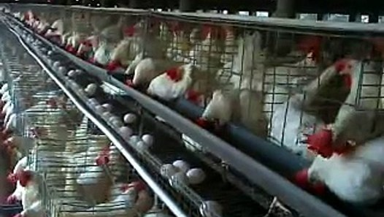
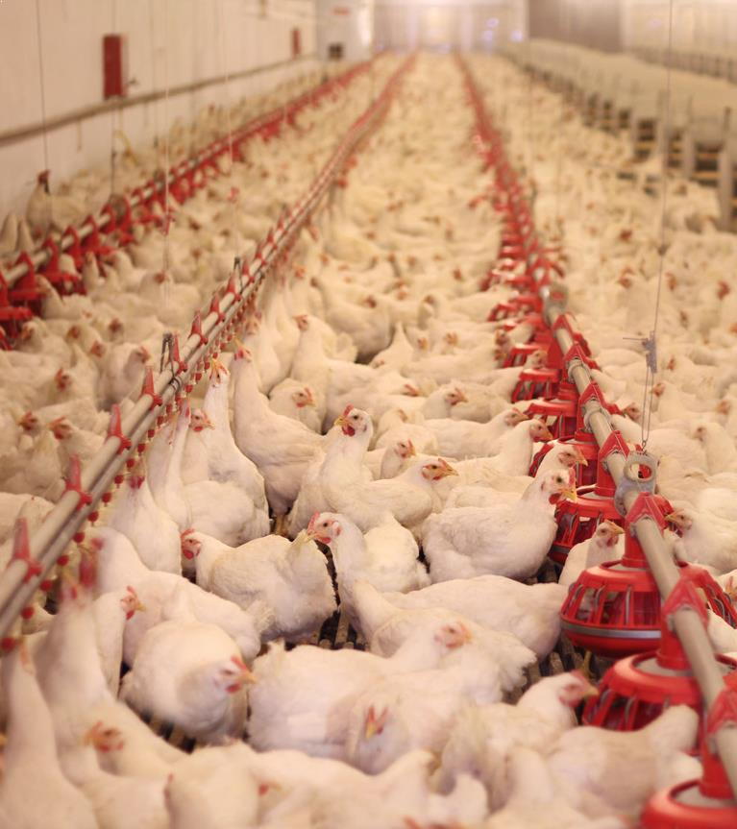
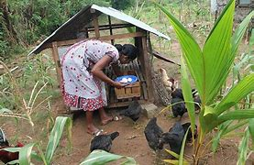
Poultry sector transformation as an industry
2020
Before 1980
Backyard
Commercial industry with high tech.

Slide 11
Poultry production

Slide 12
Animal Feed Production (000 Mt)
Type | Production (2016) | Production (2021) | Change (%)
Poultry feed (commercial) | 620.31 | 1025.93 | 65%
Cattle feed | 40.85 | 64.48 | 57%
Self mixed (layer feed) | 413.54 | 258.30 | - 38 %
Total feed | 1,078.65 | 1362.57 | 26 %
Animal feed raw material production & imports (000 Mt) - 2021
Type | Requirement | Local production | Imports
Maize | 600 | 432.2 | 4.8
Wheat |  | - | 200.7
SBM | 300 | 7.9 | 227.9
Fish meal & MBM | 50 |  | 40.9
USD 390 million

Slide 13
Dairy Sector
Milk production has been a “traditional practice” which has survived thousands of years in Sri Lanka
Over 85 % of the farms are small scale(< 10 cattle/buffalo)
Still a subsistence level farming practice
Highly depend on family labour
Mainly a secondary income generating source (>85%)
Milk is a ‘cash crop’ for small scale dairy farmers; converting their family labour into a value added market commodity
Plays an important role in rural economy
Shows slow growth rate

Slide 14
Dairy Sector Trends

Slide 15
Increasing growth rate in demand (9-10%/year)
Increasing income
Urbanisation
Socio-economic factors
etc…
Growth rate 4%

Slide 16
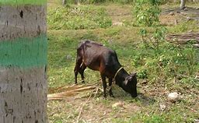
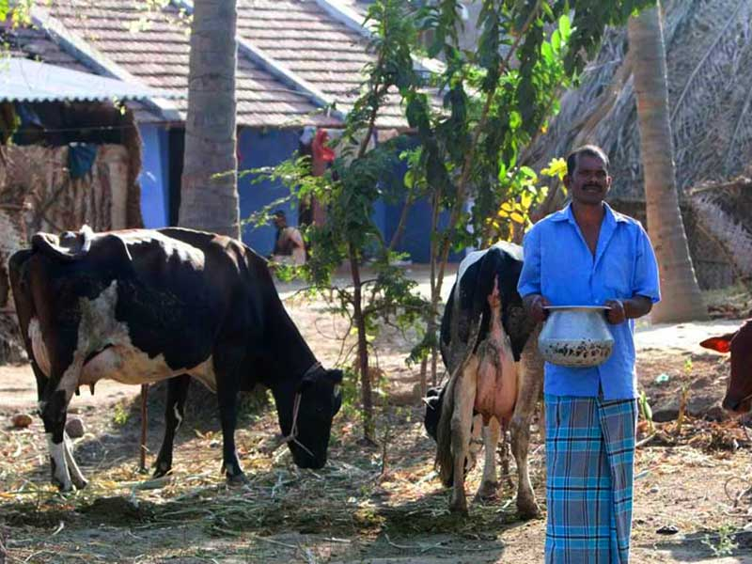
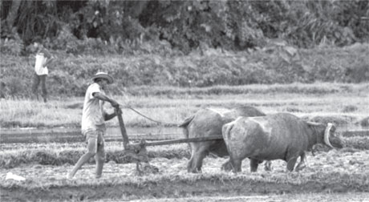
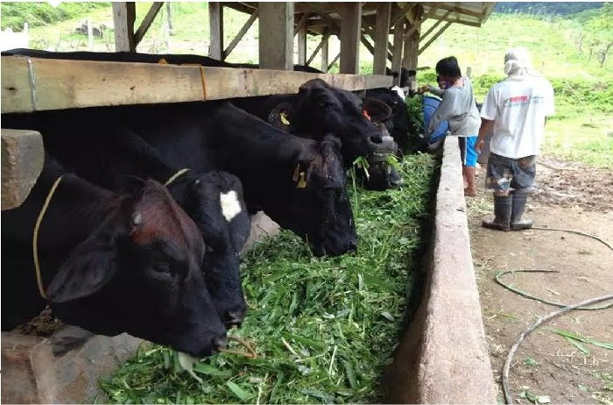
Dairy Sector Transformation
Policy initiatives for PPP
Entrepreneurship
Traditional practice
Technical Interventions
Fulfils family requirements (milk, fertiliser and draught power)
Livelihood support
e- Extension
Milk ‘cash crop’
Dairy Industry
MSMEs
Large & Mega farms
Subsidies
Incentives

Slide 17
Impact due to economic crisis

Slide 18
Livestock production in 2020-2021
Production change 2020 …2021
Milk production growth - +4.4 %
Egg production growth - +4.5%
Chicken meat production growth - +9.5 %
Livestock sector showed improvement in 2021 compared to 2020
Source: Central Bank of Sri Lanka,2021

Slide 19
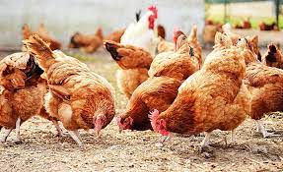
Impact on production (2022)
Livestock Production Drop-2022
Item | Milk (ML) | Chicken meat (000 Mt) | Eggs (million)
2021 production | 440 | 236 | 2934
2022 forecast(earlier) | 480 | 240 | 3017
2022 adjusted forecast | 385 | 211 | 1963
2022 drop | 95.00 | 29.00 | 1054.00
2022 drop (%) | 19.8 | 12.1 | 34.9
 | Large farm (>50%)
 | Small farm (15%)
 | Decrease imported milk
Source: Department of Animal Production and Health
Availability
drop

Slide 20
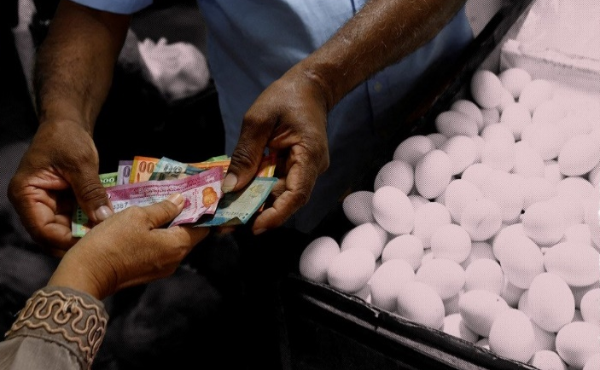
Impact on prises (2022)
Year | Chicken Meat(Rs/kg) | Eggs(Rs/egg) | Fresh milk(Rs/l)
1985 | 42.77 | 1.5 | 3.48
1990 | 70.51 | 2.42 | 6.17
1995 | 93.72 | 2.57 | 10.8
2000 | 132.96 | 4.10 | 16.64
2005 | 202.93 | 6.68 | 27.12
2010 | 327.91 | 13.9 | 54.00
2015 | 388.26 | 14.72 | 86.00
2020 | 531.49 | 21.48 | 92.00
2021 | 637.11 | 24.91 | 105.00
2022 | 1350.00 | 50.00 | 150.00
5 year av.
41 %
5 year av.
46 %
5 year av.
56 %
Affordability
drop
High impact
112 %
101 %
42 %
Source: Department of Animal Production and Health

Slide 21
Way forward towards 2030

Slide 22
Way-forward towards 2030
Dairy Sector
Increase milk production by accelerating the growth to achieve 100% self sufficiency by 2030

Slide 23
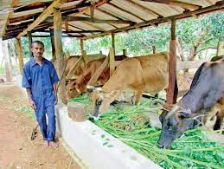
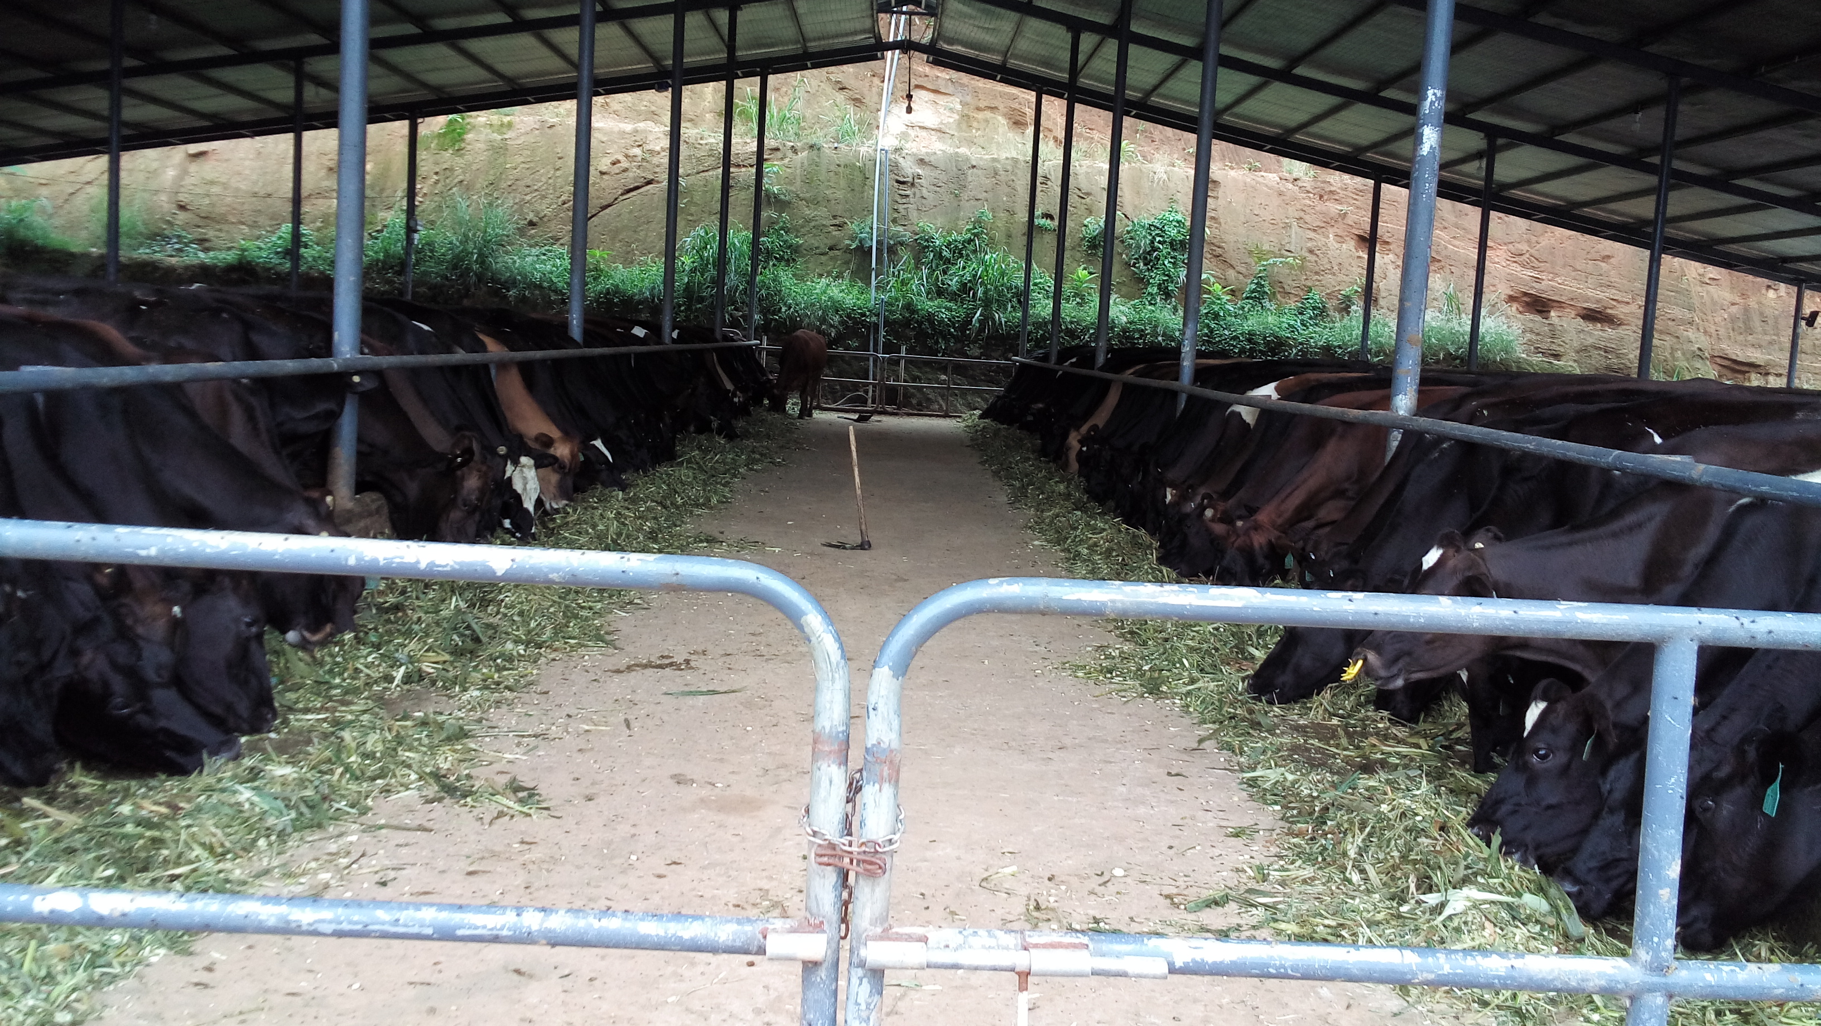
Strategies
Transform subsistence level farms
into profit oriented systems (15,000 farms)
Business Models for MSMEs
Key Performance Indicators (KPIs)
Facilitate large & mega dairy farms
Develop climate smart dairy models to increase production efficiency
Sustainability through productivity & profits

Slide 24
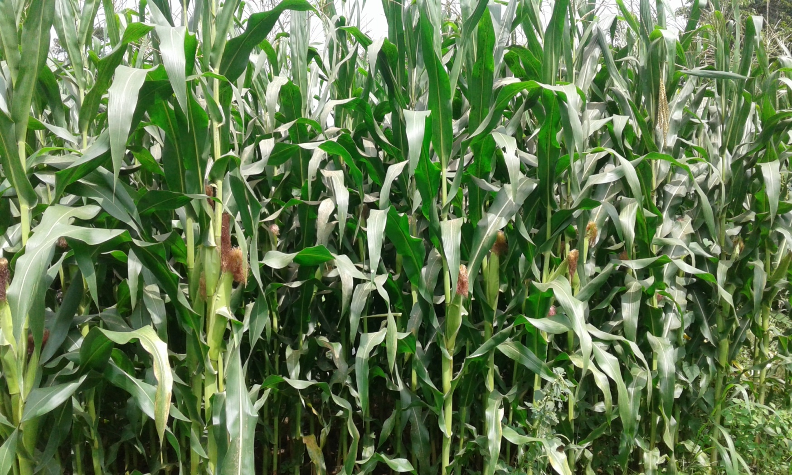
Strategies
Introduce high yielding fodder
varieties to increase production efficiency
Develop PPP in extension
Focused farmer group approch
Introduce e-Extension (IT based awareness)
Sustainability through new interventions

Slide 25
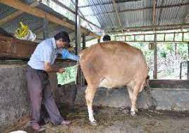
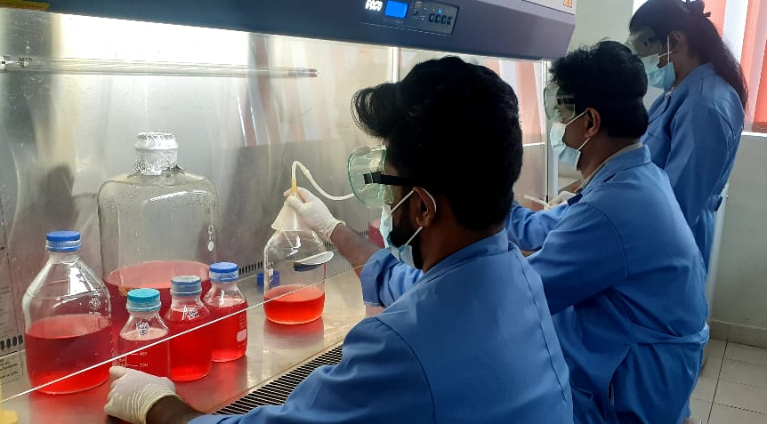
Strategies
PPP in service providing activities
Increase local production of veterinary vaccines, drugs, feed additives
Facilitate local vaccines
Joint ventures (Private sector)
Sustainability through PPP

Slide 26
Way-forward towards 2030
Poultry Sector
To be self sufficient ( > 80%) in animal feed inputs by facilitating maize and soya growers
To increase exports of chicken meat and eggs substantially

Slide 27
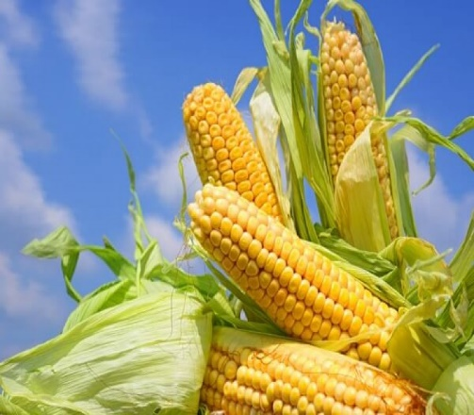
Strategies
Strategies
Facilitate growers (Maize, Soya bean) - DoA,CB
Facilitate processors (Fish meal/MBM) - DoF,BOI
Promote family poultry with locally available feed rations in rural areas
Decrease the import dependency

Slide 28
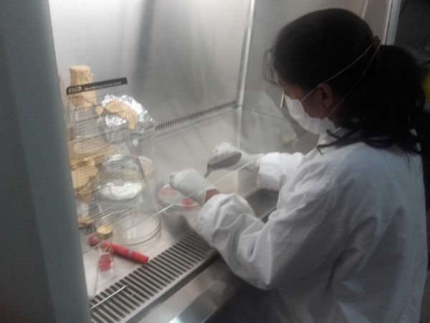
Strategies
Export Facilitation
Better Coordination – MoH & MoFA
Strengthen the regulatory mechanism
Veterinary Public Health certification
GAHP certification
Increase Foreign Earnings

Slide 29
Conclusion

Slide 30
Conclusion
Livestock sector has been developing to ensure the food security in animal products
Economic crisis has impacted significantly in poultry sector due to high import dependency
Immediate measures have to be taken to reduce the import dependency
Policy initiatives are due for PPP in addressing the gaps in dairy development

Slide 31


